Slide 1
Functions and Recursion

Slide 2
Function: A named sequence of statements that performs some useful operation. Functions may or may not take arguments and may or may not produce a result.
Function definition: A statement that creates a new function, specifying its name, parameters, and the statements it executes.
Function call: A statement that call a function definition to perform a specific task.

Slide 3

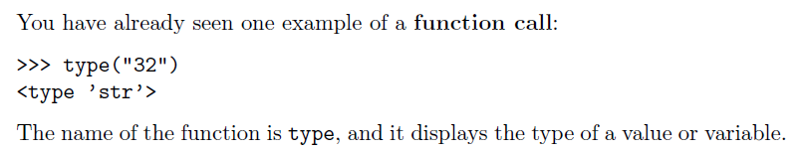
Function calls

Slide 4
>>> type(“32”)
Function Name
Arguments
<type ‘str’>
Return Value
Notes:
So ,Guys how many of you are afraid of programming ???? , who think that coding is the most difficult thing to do ??? Pick one of them and ask him/her the recipe of Maggi or tea …

Slide 5
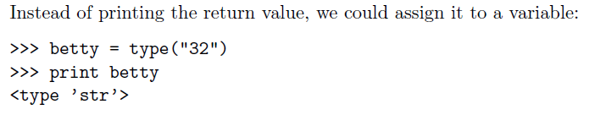

Slide 6
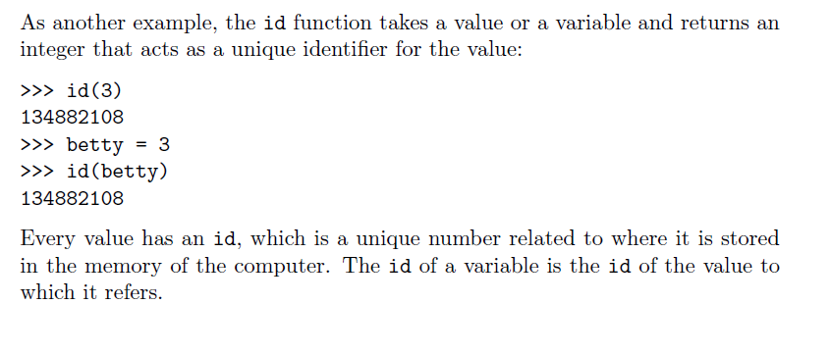

Slide 7
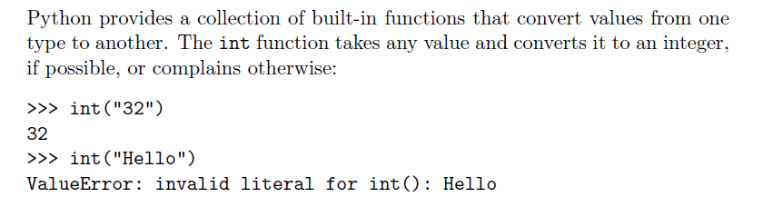
Type conversion

Slide 8
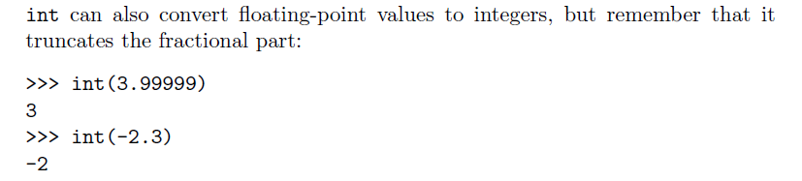
Float to integer conversion

Slide 9
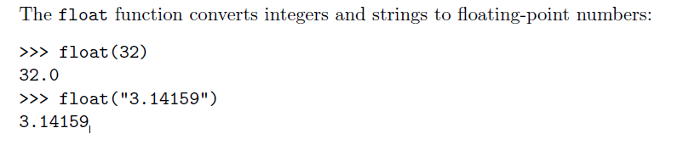
Integer and String Conversion to Float
Notes:
We all know YouTube as the place to upload cat videos and fails. As one of the most popular websites in existence, it provides us with endless hours of video entertainment. The Python programming language powers it and the features we love.

Slide 10
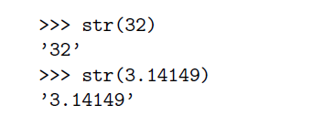
Integer and Float Conversion to String
Notes:
DropBox started the online document storing revolution that has become part of daily life. We now store almost everything in the cloud. Dropbox allows us to store, sync, and share almost anything using the power of Python.

Slide 11
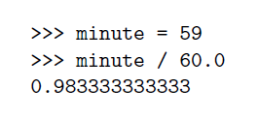
Type coercion
Rules for automatic type conversion is know as Type coercion.
For example,
By making the denominator a float, we force Python to do floating-point division.
Notes:
Survey Monkey is the largest online survey company. They can handle over one million responses every day on their rewritten Python.

Slide 12
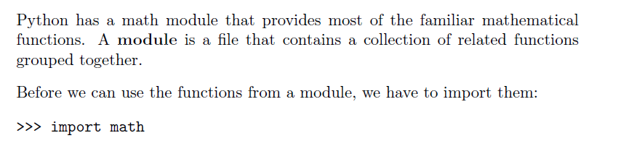
Math Functions
Notes:
Python also provides the power behind the most popular search engine in the world – Google. The programming language can handle the traffic and computing needs of the search engine and its connected apps.

Slide 13
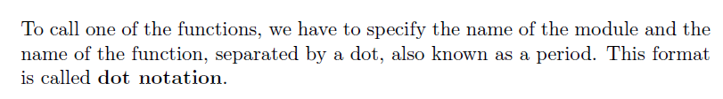
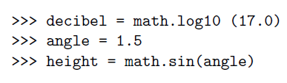
Calling a Math Function
For Example,
Notes:
Quora is the number one place online to ask a question and receive answers from a community of individuals. On their Python website relevant results are answered, edited, and organized by these community members.

Slide 14
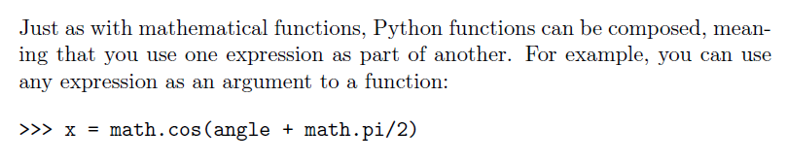
Composition
Notes:
A majority of the code for Bitly URL shortening services and analytics are all built
with Python. Their service can handle hundreds of millions of events per day.

Slide 15
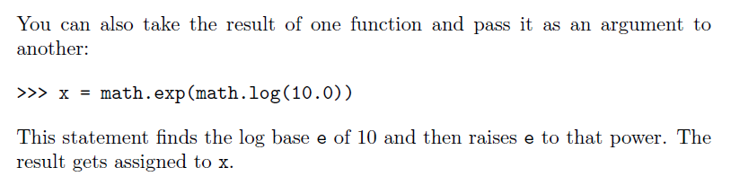
Composition
Notes:
Reddit is known as the front page of the internet. It is the place online to find information or entertainment based on thousands of different categories. Posts and links are user generated and are promoted to the top through votes. Many of Reddit’s capabilities rely on Python for their functionality.

Slide 16
Mathematical Functions
abs(x)
Ceil(x)
cmp (x, y)
exp (x)
Floor(x)
Log(x)
pow (x,y)
sqrt(x )
Max (x1,x2….xn)
Min (x1,x2…xn)
Notes:
import math
print abs(5.23)
print cmp(20,10)
print max(10,20,30)
print min(10,20,30)
print math.log(10)
print math.log10(10)
print math.ceil(2.3)
print math.floor(2.3)
print math.exp(3)
print math.pow(2,3)
print math.sqrt(4)

Slide 17
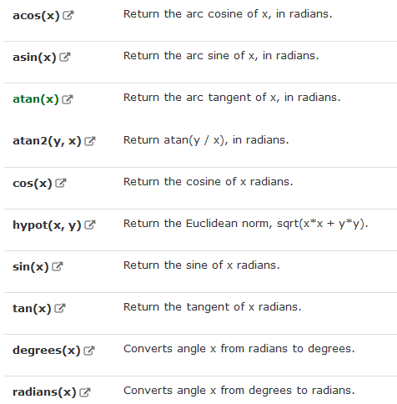
Trigonometric Functions

Slide 18

Adding new or user defined functions
A function is a named sequence of statements that performs a desired operation. This operation is specified in a function definition.
The syntax for a function definition is:
Notes:
Yahoo maps may be losing the battle to other map service providers, but it still holds some powerful tools. Yahoo’s map program runs on Python as well as many of its other programs.

Slide 19
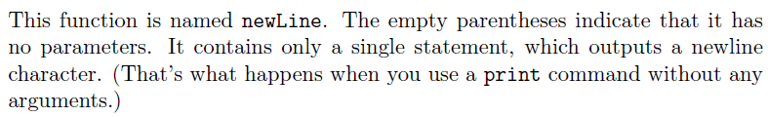
Example,
Def newLine():
Print
Notes:
So now lets start with Python …..For your better Future.
You can be placed in one of these companies ,if you are expert in python. You don’t need to approach them , then they will approach you.

Slide 20
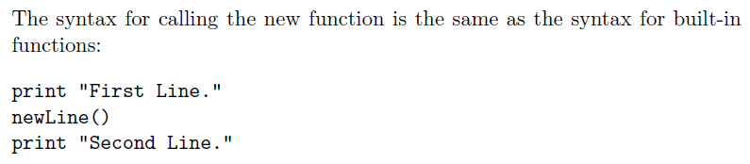

Calling user defined functions
Output of the program is:

Slide 21
Why we need to create functions
Creating a new function gives you an opportunity to name a group of statements. Functions can simplify a program by hiding a complex computation behind a single command and by using English words in place of arcane code.
Creating a new function can make a program smaller by eliminating repetitive code.

Slide 22
Few points to remember
Only the function definition generates no output.
The statements inside the function do not get executed until the function is called.
You have to create a function before you can execute it. In other words, the function definition has to be executed before the first time it is called.

Slide 23
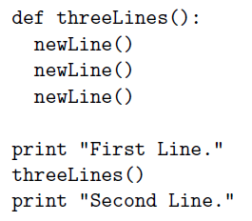
Flow of execution
In order to ensure that a function is defined before its first use, you have to know the order in which statements are executed, which is called the flow of execution.
3
4
5
6
1
Execution Starts
2
7

Slide 24
Parameters and arguments
Arguments are the values that control how the function does its job.
For example, if you want to find the sine of a number, you have to indicate what the number is. Thus, sin takes a numeric value as an argument.
Some functions take more than one argument. For example, pow takes two arguments, the base and the exponent. Inside the function, the values that are passed get assigned to variables called parameters.

Slide 25

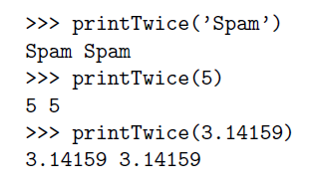
Function Definition
with arguments
Function Call
with arguments of
type String, Integer
and float respectively

Slide 26
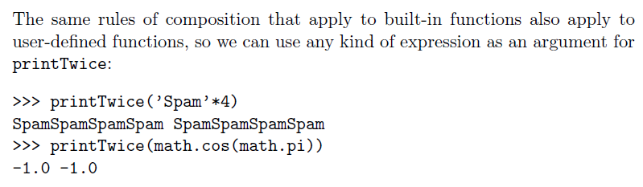
Composition for user defined functions

Slide 27
Variables and parameters are local
When you create a local variable inside a function, it only exists inside the function, and you cannot use it outside. For example:
def catTwice(part1, part2):
cat = part1 + part2
print cat
>>> a= “Python”
>>> b=“Class”
>>> catTwice(a,b)

Slide 28
When cat Twice terminates, the variable cat is destroyed. If we try to print it,
we get an error:
>>> print cat
NameError: cat
Parameters are also local. For example, outside the function catTwice(part1, part2), there is no such thing as part1 and part2

Slide 29
Stack Diagram for functions
To keep track of which variables can be used where, it is sometimes useful to draw a stack diagram.
Stack diagram is used to represent the state of a program during a function call.
Each function is represented by a frame. A frame is a box with the name of a function beside it and the parameters and variables of the function inside it.

Slide 30
a “Python”
b “Class”
_main_
catTwice
Part1 “Python”
Part2 “Class”
Cat “Python Class”

Slide 31
Functions with results
def sum (x,y):
return x+y
>>> a=sum(8,9)
>>> print a
17

Slide 32

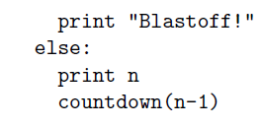
Recursion
It is legal for one function to call another, and you have seen several examples of that.
But it is also legal for a function to call itself.
For example,

Slide 33
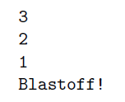
>>> countdown(3)
OUTPUT of this function will be :
Notes:
The execution of countdown begins with n=3, and since n is not 0, it outputs the value 3, and then calls itself...The execution of countdown begins with n=2, and since n is not 0, it outputs the value 2, and then calls itself...
The execution of countdown begins with n=1, and since n
is not 0, it outputs the value 1, and then calls itself...
The execution of countdown begins with n=0, and
since n is 0, it outputs the word, \Blasto!" and
then returns.
The countdown that got n=1 returns.
The countdown that got n=2 returns.
The countdown that got n=3 returns.
And then you're back in main

Slide 34
Stack diagrams for recursive functions
Earlier we used a stack diagram to represent the state of a program during a function call. The same kind of diagram can help interpret a recursive function.
Every time a function gets called, Python creates a new function frame, which contains the function's local variables and parameters. For a recursive function, there might be more than one frame on the stack at the same time.

Slide 35
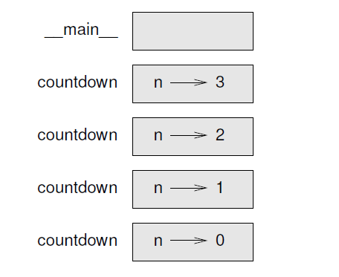
Following figure shows a stack diagram for function countdown (n) called with n = 3:
Notes:
The top of the stack is the frame for __main__ . It is empty because we did not create any variables in main or pass any arguments to it.

Slide 36
Infinite recursion
If a recursion never reaches a base case, it goes on making recursive calls forever, and the program never terminates. This is known as infinite recursion, and it is generally not considered a good idea. Here is a minimal program with an infinite recursion:
def recurse () :
recurse()
Function is calling
itself without any
condition to terminate
The recursive call

Slide 37
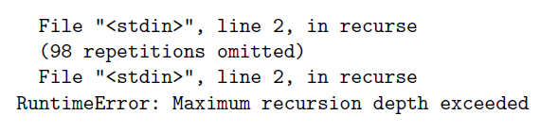
In most programming environments, a program with infinite recursion does not really run forever. Python reports an error message when the maximum recursion depth is reached:

